Slide 1



NAVYUG VIDYABHAVAN TRUST
C. K. Pithawala College of Engineering & Technology, Surat
Department of Computer Engineering
IPL DATA ANALYTICS DASHBOARD
Insights & Tactical Metrics (2008 – 2024)
PRESENTED BY
FACULTY GUIDE
Patel Jeet Hasmukhbhai
Prof. Pooja Pariyani
Enrollment: 230090107137
Assistant Professor, Computer Engg.

Slide 2









Presentation Outline
1. Company Brief
2. Domain & Tech Stack
3. Work Profile
Overview of Karon Infotech, Surat, and Kaggle open dataset repository for sports analytics.
Financial & Sports Analytics domain, utilizing Python (Pandas), SQL, and Power BI.
Task and project deliverables including the 5-tier Power BI dashboard views.
4. Type of Engagement
5. Weekly Progress
6. Key Outcomes
Project execution details, schedule, learning objectives, and pipeline methodology.
Chronological breakdown of data cleaning, database staging, and dashboard building.
Insights on 1,095 matches, toss conversion, venue profiles, and player benchmarks.

Slide 3




Company Brief & Organization
Karon Infotech, Surat
Dataset Partner (Kaggle)
Overview: Established enterprise IT consulting and software development firm based in Surat, Gujarat.
Data Origin: Open-source historical IPL dataset gathered from Kaggle repositories.
Domain Expertise: Full-stack web platforms, mobile apps, enterprise data engineering, and Business Intelligence solutions.
Volume: 1,095 matches & 200,000+ ball-by-ball delivery microdata spanning 16 seasons (2008 – 2024).
Website: https://karoninfotech.com/about/
Coverage: 14 distinct franchises, 58 stadiums across India, UAE, and South Africa.

Slide 4




Domain & Technology Stack
Python (Pandas)
SQL Relational Staging
Microsoft Power BI
Excel & GitHub
Data cleaning, imputing missing cities, deduplication, and franchise name normalization.
Structuring normalized Star Schema, Fact tables, and Dimension lookup views.
Building 5 interactive dashboard pages with custom DAX measures and slicers.
Initial dataset audit, CSV preprocessing, version control, and project documentation.

Slide 5
Work Profile & Project Scope
Executive Overview Page: Top KPIs, total matches (1,095), toss win conversion %, and batting first vs chasing advantage.
Team Analysis Module: Franchise win/loss records, toss conversion rates, and multi-year seasonal win trajectories.
Match Insights Page: Scoring dynamics, lowest defended totals (108), highest chases (263), and victory margins.
Venue Analysis Module: Geospatial map plotting 58 stadiums across India, UAE, and South Africa with ground par scores.
Player Intelligence Page: Top run-scorers (S. Raina: 2,340), top wicket-takers (S. Malinga: 85), and Strike Rate scatter plots.

Slide 6

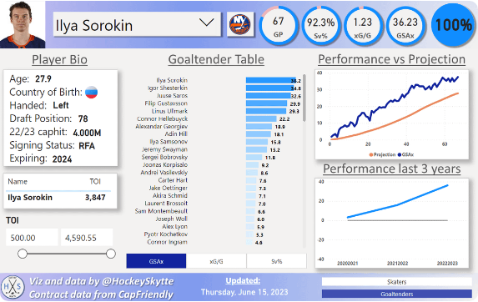

Dashboard Visual Showcase
Multi-Tier Analytics Dashboard
Built using Microsoft Power BI Desktop, the interactive dashboard processes 1,095 matches and 200,000+ delivery rows cleanly.
Key Feature: Fully synchronized slicers across Season, Team, Venue, and Toss Decision with one-click reset bookmarks.

Slide 7


Type of Engagement & Workflow
Engagement Overview
Data Processing Pipeline
Structure: Full-time academic & industry project engagement focused on sports business intelligence.
1. Ingestion: Raw Kaggle CSVs (matches.csv & deliveries.csv).
2. Preprocessing: Normalized team names (e.g. Delhi Daredevils → Delhi Capitals).
Execution Mode: Hands-on data cleaning in Python, relational modeling in SQL, and dashboard building in Power BI.
3. Modeling: Star Schema fact/dimension lookup tables in SQL.
Guidance: Technical direction from Karon Infotech mentors & GTU faculty guide Prof. Pooja Pariyani.
4. DAX Expressions: Dynamic measures for win %, toss conversion %, and strike rates.

Slide 8






Project Execution Timeline
Week 1 – Audit
Week 2 – ETL
Week 3 – Schema
Week 4 – Dashboard
Acquired Kaggle datasets, performed initial data quality audit, identified nulls & team rebrands.
Developed Python Pandas scripts to clean records, impute stadium cities, and derive win types.
Built SQL Star Schema with Fact_Matches, Fact_Deliveries, Dim_Teams, and Dim_Venues.
Designed 5 Power BI pages, wrote DAX measures, tested slicers, and compiled report.

Slide 9

Key Analytical Insights
1,095
53.7%
50.6%
156.4
TOTAL MATCHES
CHASING WINS
TOSS CONVERSION
AVG 1ST INN SCORE
Summary Findings: Chasing teams hold a statistically significant advantage (53.72% wins). Teams winning the toss convert 50.59% of matches into victories. High-scoring venues like Brabourne (180 avg) and Chinnaswamy (174 avg) demand significantly higher 1st innings targets.

Slide 10

Thank You!
Questions & Discussion
Patel Jeet Hasmukhbhai (230090107137)
C. K. Pithawala College of Engineering and Technology, Surat

Slide 11

Image Sources
https://preview.redd.it/is-anyone-out-there-using-power-bi-to-do-sports-analytics-v0-7wsenzgjfu6b1.png?width=1080&crop=smart&auto=webp&s=0b9cfd53a15f1b72b8e92bb630c7969af896973e
Source: www.reddit.com

